Slide 1
Indoor Climate Control System
Victor Florea
Ivo Belitts
Valentin Stoyanov
Yvan Koopmans

Slide 2
What was expected
A system that can “ventilate” a room based on measurements done by various wireless sensors
sensors communicate wirelessly with a “ventilation box” over ZigBee
Based on these measurements the “ventilation box” can decide if and how much it should ventilate the room to improve the indoor climate

Slide 3







Our Vision
Fan
Server
Sensors
Windows in the room
Second board
Nucleo board
Main app

Slide 4
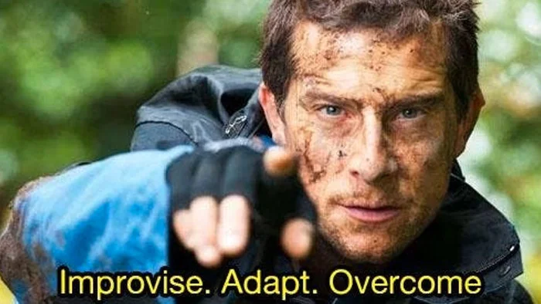
How did we managed to solve the problems caused by the pandemic?

Slide 5
What we delivered
Wireless communication between sensors and ventilation box over tcp
Ventilation system based on measurements
Graphic visualization of the readings
A log file that records the data read

Slide 6
Current State (affected by the pandemic situation)
Fan
Server
Sensors
Windows in the room
Simulated LAN
Auxiliary Application
Second board
Main app

Slide 7
Main Application
Overview
Thresholds (display/modify)
Visual graph
Notes:
What can you do in the app (Yvan)

Slide 8
Simulated LAN && Auxiliary application
TCP connection
ZeroTier One – VPN
local network
Notes:
Given the fact that each one of us took a sensor they couldn’t be connected to the same board… short description of what the app really does. (Ivo)

Slide 9
Server connection
Http protocol (Post requests)
Non-blocking
Notes:
Short description on how it s made (Valentin)

Slide 10
Second board (simulated)
What is it?
How does it work?
Extra features
Notes:
Short description (Victor)

Slide 11
What we learned from this experience?
Work better as a team
There is a solution to every problem
Work effectively while being remote
Using all resources available to help us achieve our goal

Slide 12
Future improvements
Database for more efficient data management
Easy access to previous measurements
Improving the ventilation algorithm
Adding more sensors (eg: brightness)
Performance optimization of the application

Slide 13


Questions?

Slide 14

Let us show our demo

Slide 15
Thank you!

